Slide 1
Bike Helmets & Bike Safety
(your name)
May 25, 2022

Slide 2
Trainees: how to use these slides
Previous trainees have said they only have about 15 minutes to deliver their presentation and answer questions. You may want to delete slides to what’s most useful to your institution/locality.
Similarly, there’s a lot of info on these slides. You may want to edit the slides to keep the most salient points for your talk.
Be sure to edit the first and last slide with your name and contact info.
You are welcome to re-brand or co-brand this presentation.
Delete this slide once you’ve addressed these issues.

Slide 3
Your family is going on a bike ride.
Who needs to wear a helmet?
Children older than one year sitting in a child bike seat on an adult’s bike
Children older than one year sitting in a bike trailer attached to the back of an adult’s bike
Children riding on a trailer bike (often called by the brand name Trail-a-bike) attached to the back of an adult’s bike
Children or teens riding their own balance bike, tricycle or bicycle with or without training wheels
Adults/parents riding a bike
All of the above
Notes:
The answer is F, all of the above. While state and city laws enforcing helmet use vary, safety guidelines are universal: everyone on a bike of any type needs to wear a helmet on every ride. Many areas have laws requiring helmets for children under age 16 or 18 years but adults’ heads are just as important to protect. It’s also important for parents to role model helmet use. Make it a rule: no helmet, no riding. Children younger than one year should not wear a helmet because of poor neck strength. They should not be on a bike in any capacity.

Slide 4
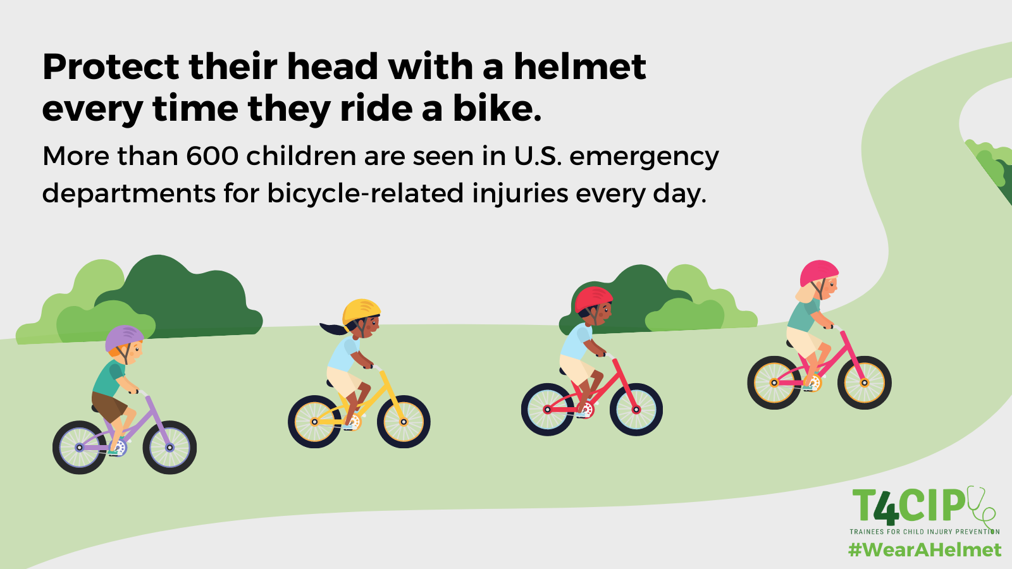
How often do bicycle-related injuries occur?
Every year in the U.S., more than 220,000 children younger than 18 years visit the emergency department with bicycle-related injuries. That’s more than 600 each day or 25 every hour.

Slide 5
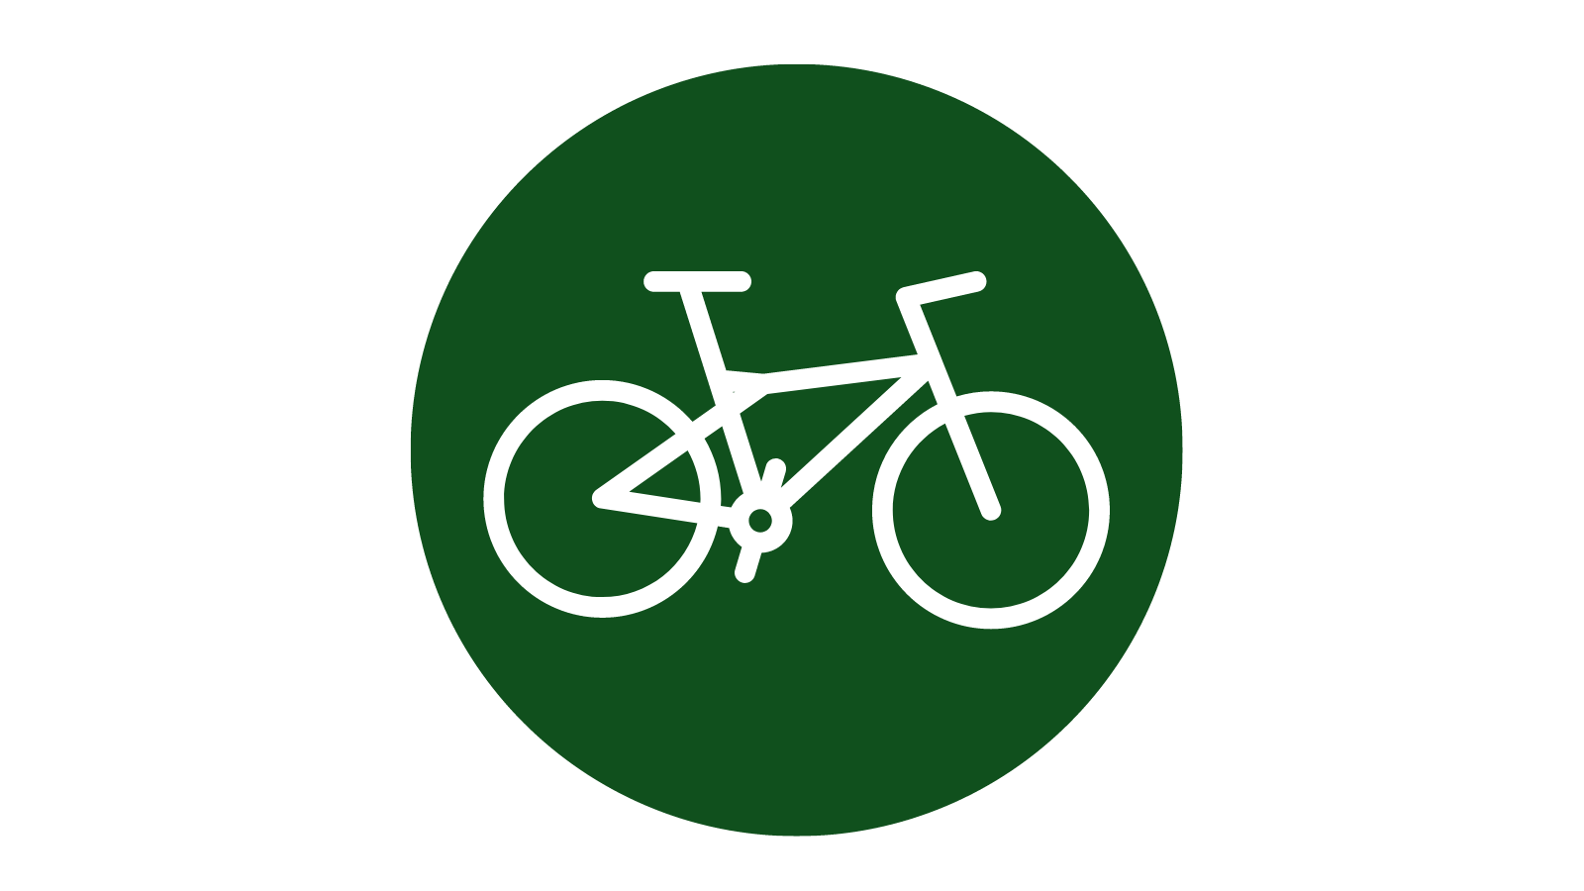
Bicycle-related injuries
Bicycles remain associated with more childhood injuries than any other consumer product except the automobile
Most common types of injuries:
  Bruises
  Cuts
  Broken bones
Arms and legs are injured the most, but head injuries are the most serious and cause the most deaths

Slide 6
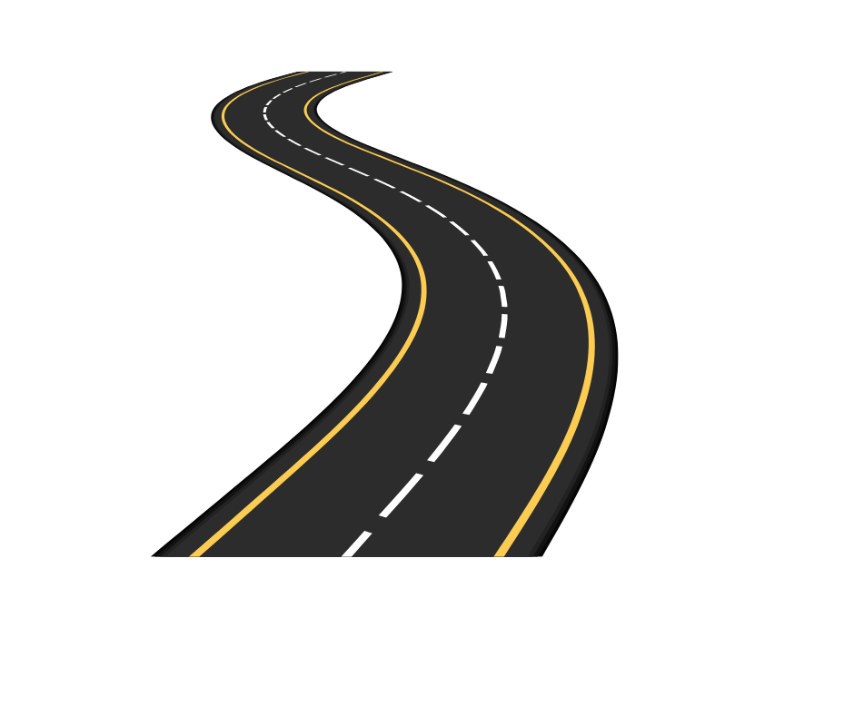
Who is at risk of bicycle-related injuries?
Boys are more likely to be injured while riding bicycles than girls.
Most of the injuries to children occur to kids ages 5-14 years.
Older children ages 15-18 years are injured less often, but their injuries are usually more serious. These teens are 4 times more likely to die from a bicycle-related injury than younger children.
Most injuries occur on the street.
https://www.nationwidechildrens.org/research/areas-of-research/center-for-injury-research-and-policy/injury-topics/sports-recreation/bicycle-safety

Slide 7
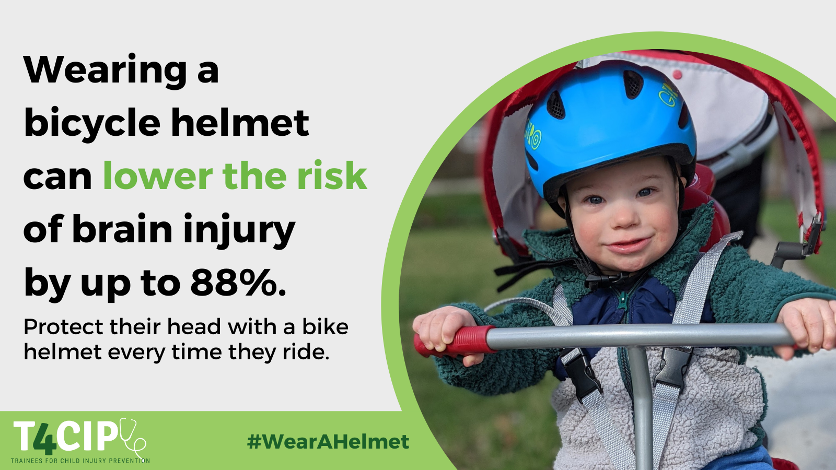
Bicycle-related injuries
Many serious injuries can be prevented by wearing a helmet.
Helmet use reduces the risk of:
  Head injury by 85%
  Severe brain injury by 88%
  Facial fractures by 31%
9 out of 10 bicycle riders who die in crashes are not wearing helmets
It is estimated that 75% of bicycle related fatalities among children (<18 years) could be prevented with a bicycle helmet

Slide 8
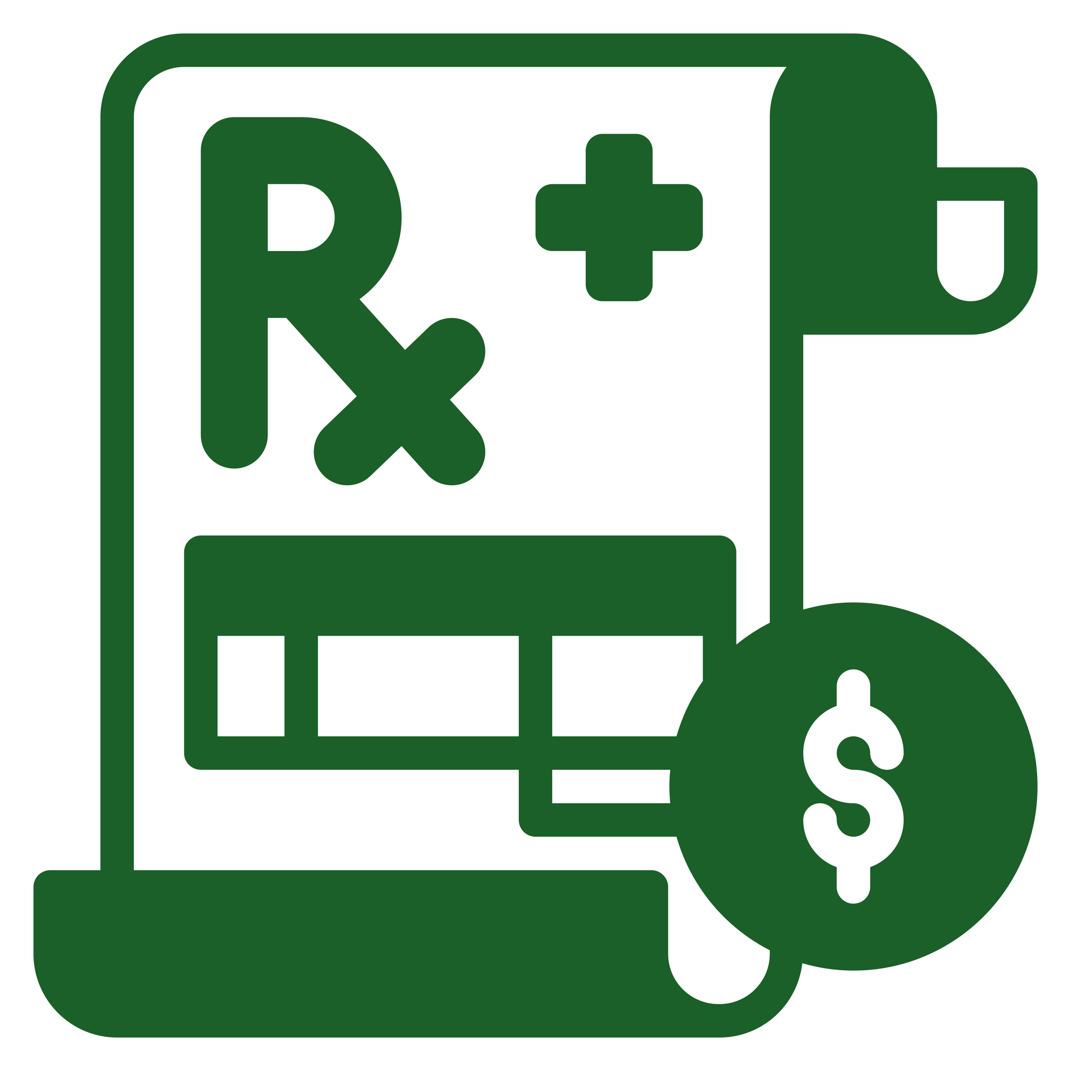
Healthcare Costs
Total annual cost of traffic-related bicyclist death and injury among children 14 and under is more than $2.2 billion
Every dollar spent on a bike helmet saves society $30 in direct medical costs and other costs
85% → $109-$142 million
Notes:
If 85% of all child cyclists wore bike helmets, in one year, the lifetime medical cost savings could total between $109-142 million

Slide 9
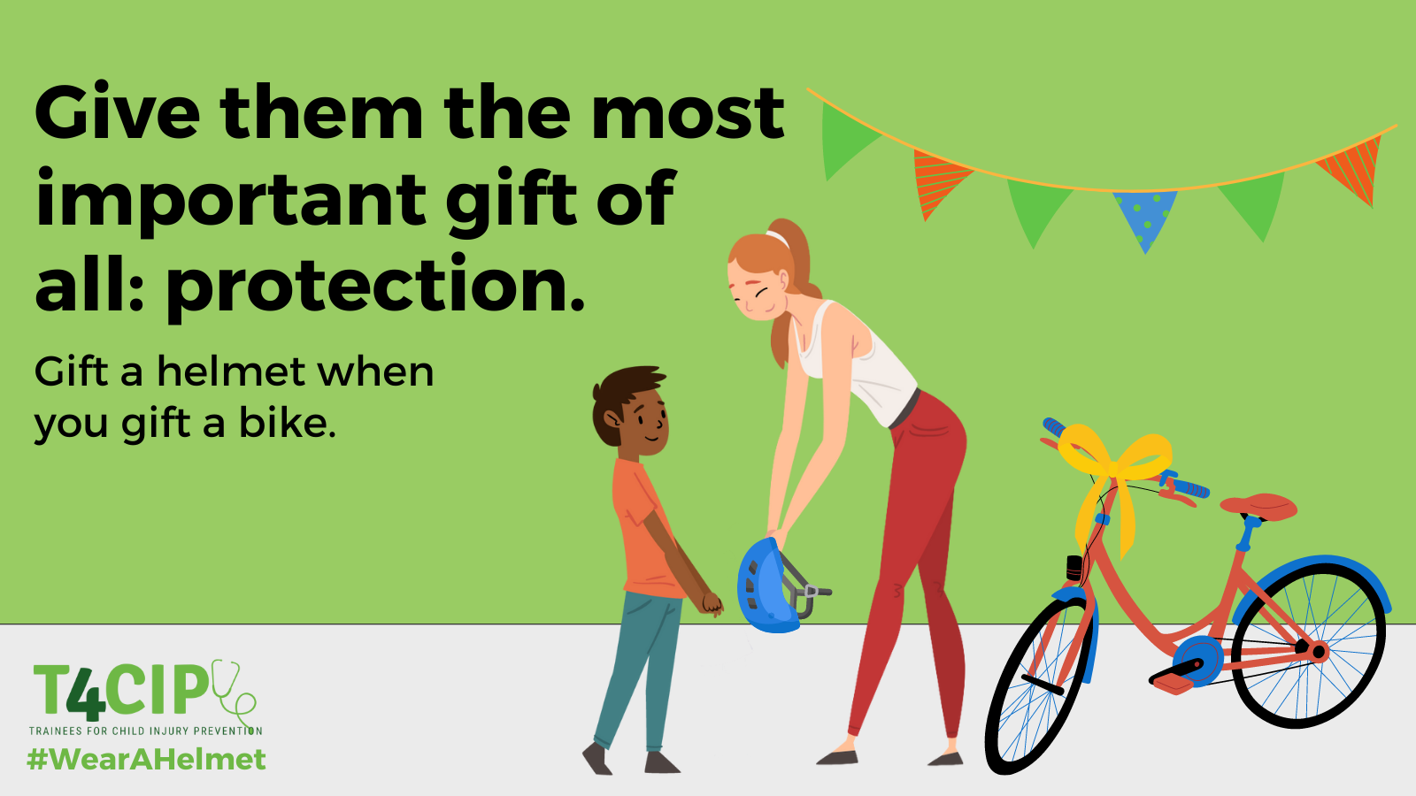
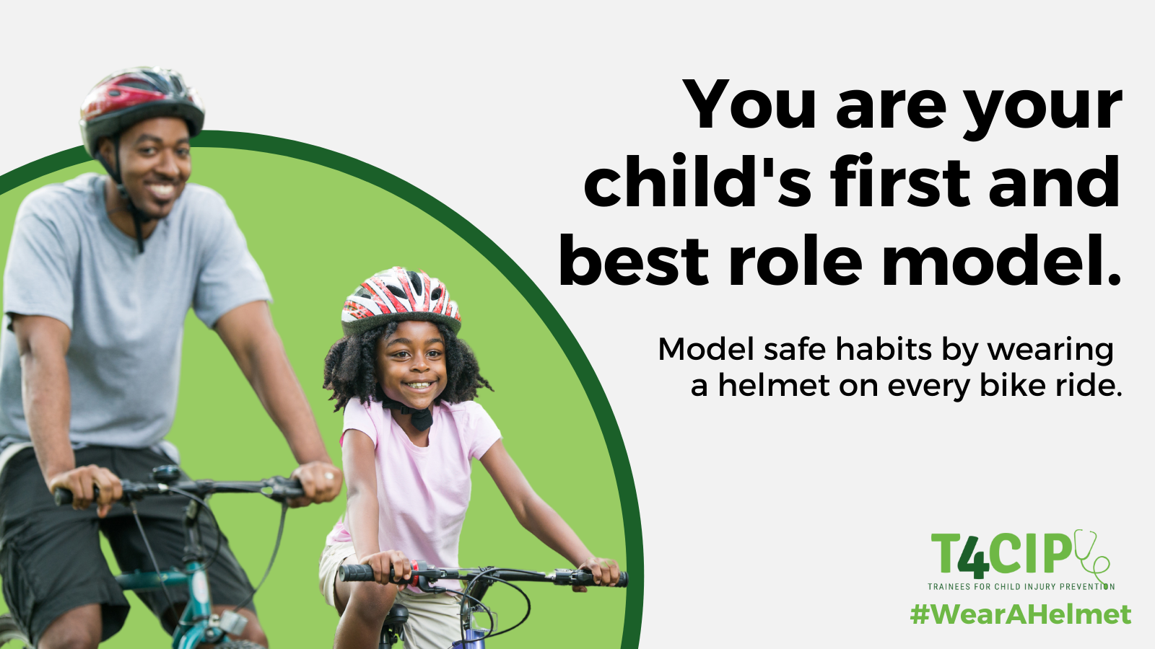
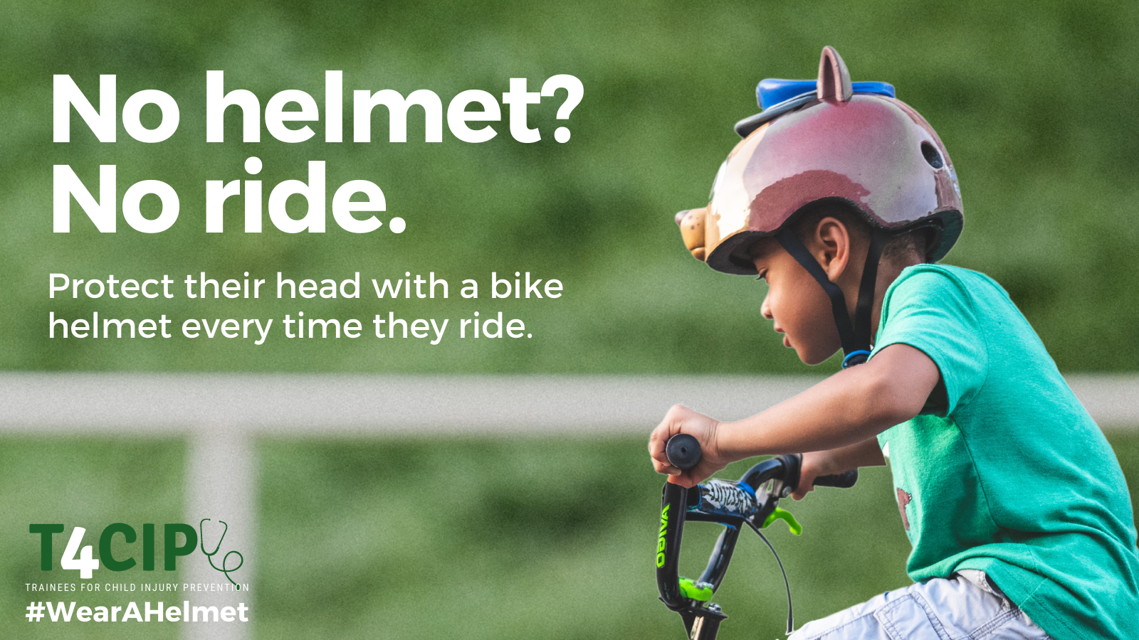
What can parents and caregivers do to protect kids and teens while riding bikes?
Always wear a helmet. Everyone on a bike of any type needs to wear a helmet on every ride.
When giving a bicycle (or tricycle, skateboard, or other wheeled toy) as a gift, give a helmet too.

Slide 10
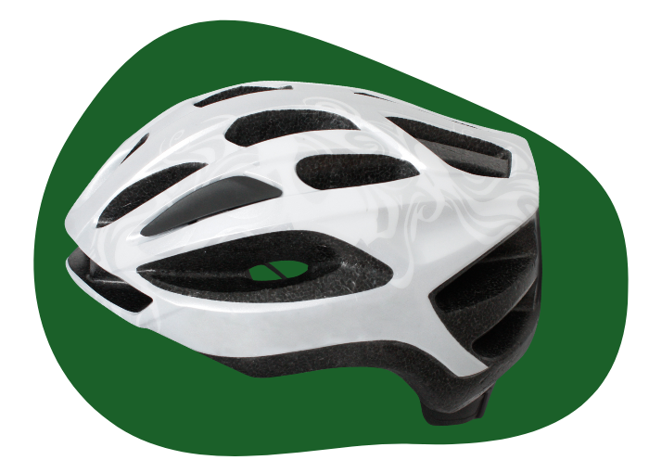
How do I pick the right helmet?
Let your child help pick out a helmet that he or she likes. Choose a bright color to help drivers see your child.
Look for the CPSC Certified label on the box.
Try the helmet on your child. It should be snug, but not tight.
If your child is between 2 sizes, pick the bigger one. Most helmets come with extra pads to help you get a good fit.
If it feels too tight, try using thinner pads. If it is still too tight, buy a larger helmet.
The helmet should not move from side to side when your child shakes his head.
Replace any helmet that is damaged or that has been involved in a crash.

Slide 11
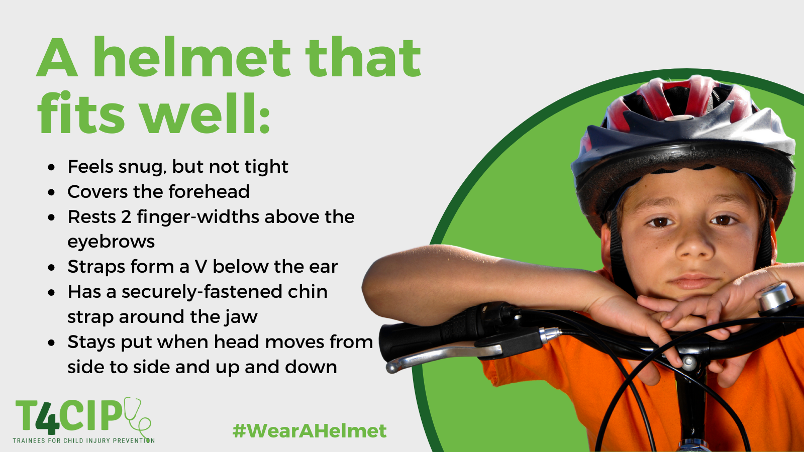
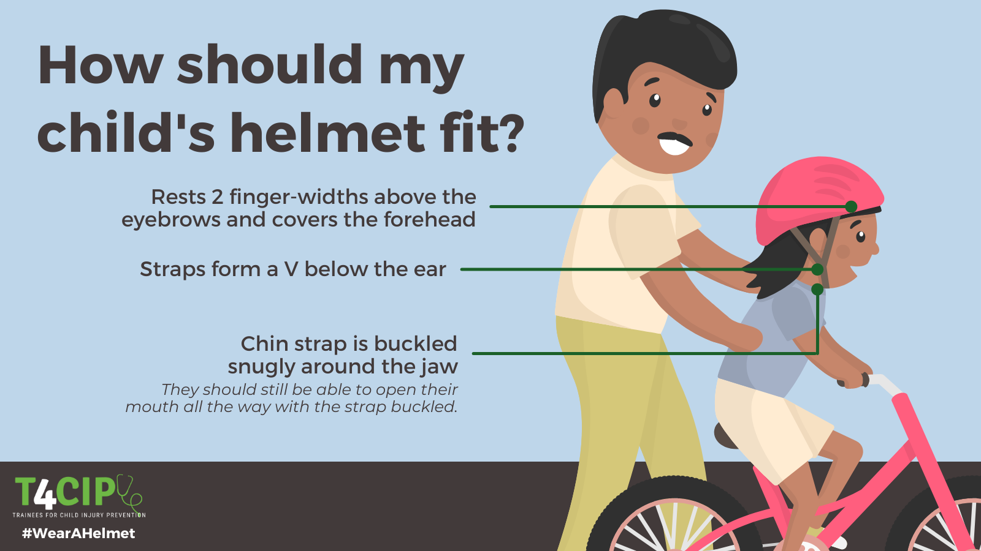
Helmet fit

Slide 12
More bicycle safety tips
Ride with traffic. Stay to the right. Do not swerve into traffic.
Follow all traffic signs. Stop at red lights and stop signs.
Use hand signals to let car drivers know what you plan to do.
Walk the bicycle across busy streets and intersections. Look left, right, and left again before crossing.
Try to ride when it is sunny and dry. Riding at dusk, when it is dark or when it is raining can be dangerous.

Slide 13
More bicycle safety tips
Children younger than 1 year of age should not be passengers on bicycles. Their neck muscles may not be strong enough to control head movement during a sudden stop, especially with the added weight of a helmet.
Children younger than 10 years should ride on a sidewalk or bicycle path instead of the street. Most children younger than 10 years are unable to make safe choices in traffic situations.
Make sure the seat and handlebars of the bicycle fit your child.
Know a child’s limits. Tell your child where he or she can ride.

Slide 14
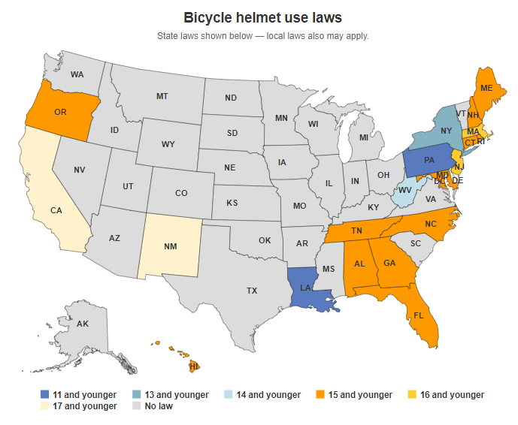
Insurance Institute for Highway Safety:
Map of bicyclists covered by state law, 2022
The odds that a bicyclist will wear a helmet are 4 times higher after a helmet law is enacted than before a law is passed.
A Gallup Poll sponsored by the US government found that 9 out of 10 surveyed support helmet laws for children <18 years

Slide 15
Helmet Legislation
Helmet use = decreased injury
- 316% ⬆ in bike helmet use in 5-14yo in Austin, TX
- 393% ⬆ in bike helmet use in children <12 in Jacksonville, FL
- ⬆ from 20.4% to 56.1% bike helmet use in Oregon
National Highway & Traffic Safety Association

Slide 16
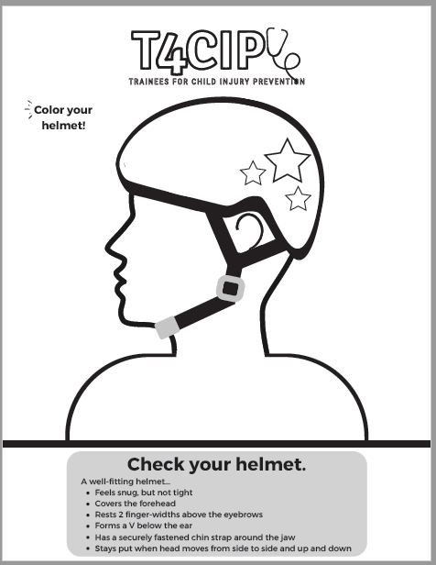

What can we, as doctors, do?
Advocate for local and state bike helmet laws
Talk about it on social media! Use #WearAHelmet on May 25, 2022 (and year round!)
  Twitter chat: May 25, 2022 at 2 p.m. ET
  Campaign materials, including social media graphics, Zoom backgrounds, selfie signs, and questions for Twitter chat: https://bit.ly/T4CIPHelmet

Slide 17
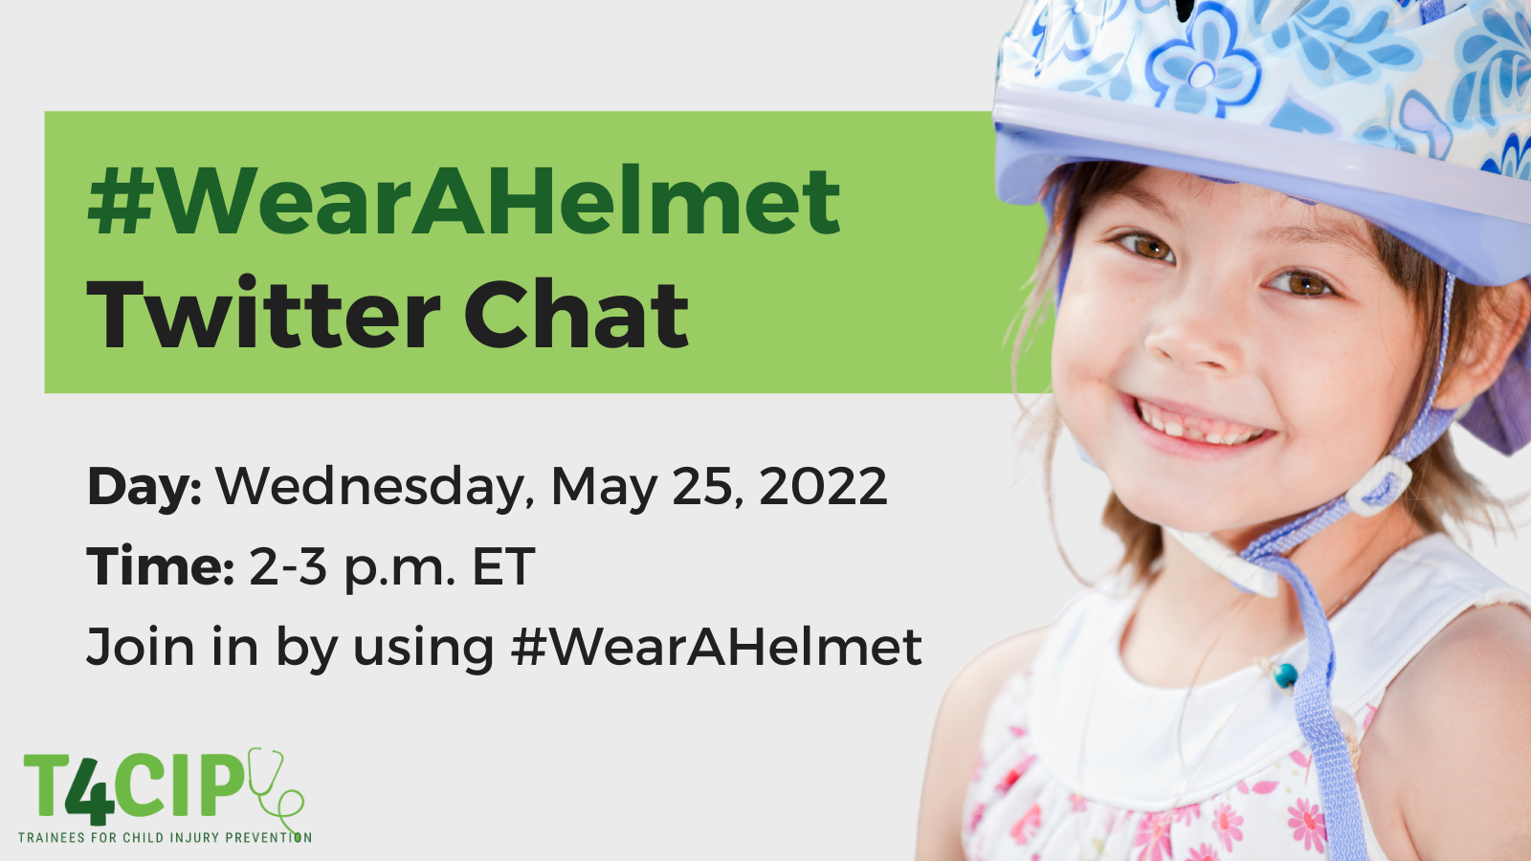

Slide 18
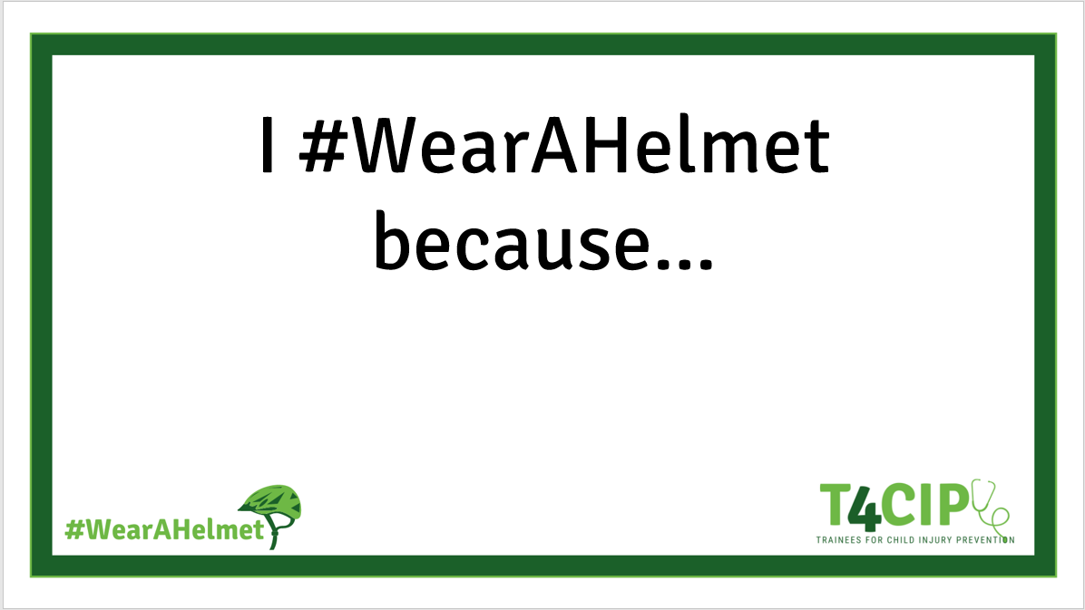
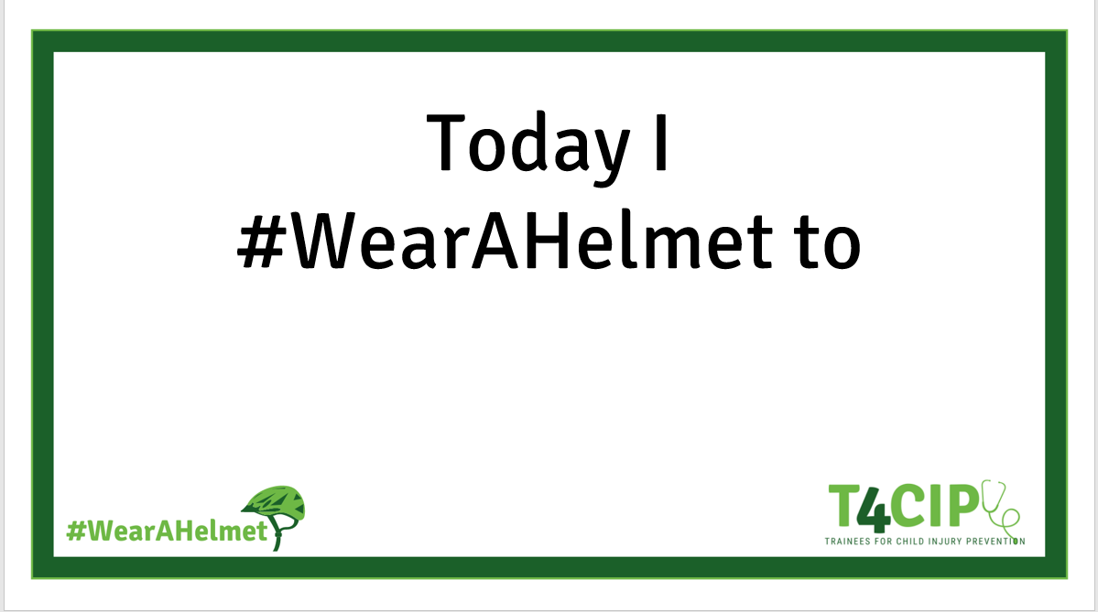
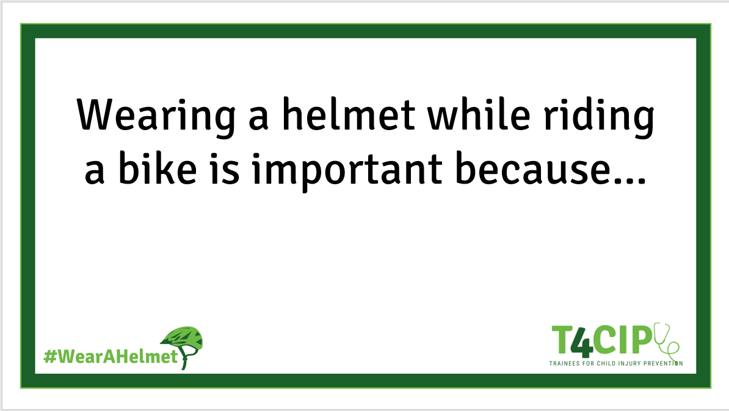
Group Photo Opp!
Notes:
Print out some of these Selfie Signs. Have people in the room fill them out and pose for a photo you can share on social media

Slide 19
References
https://www.nationwidechildrens.org/research/areas-of-research/center-for-injury-research-and-policy/injury-topics/sports-recreation/bicycle-helmets
https://www.nationwidechildrens.org/research/areas-of-research/center-for-injury-research-and-policy/injury-topics/sports-recreation/bicycle-safety
https://www.nationwidechildrens.org/family-resources-education/700childrens/2018/06/bike-helmet-safety
www.helmets.org
https://www.iihs.org/topics/pedestrians-and-bicyclists

Slide 20
(your name) your email
@yourSMhandle
Notes:
Add a slide about any other in-person events you have at your institution

