Slide 1
Booking a
Rental Car

Slide 2
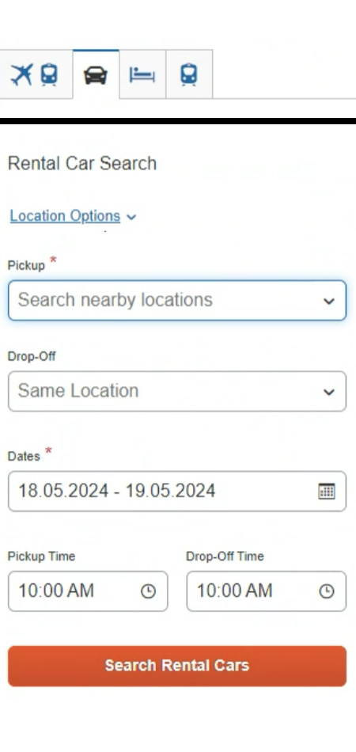
Booking a Rental Car
1
To book a rental car, on the SAP Concur home page, select the Car tab.
2
Enter your search criteria, such as the pick up and drop off locations, dates, and times, and then select Search.
For Delivery & Collection* refer to slide 9
*Applicable to EMEA travelers only

Slide 3
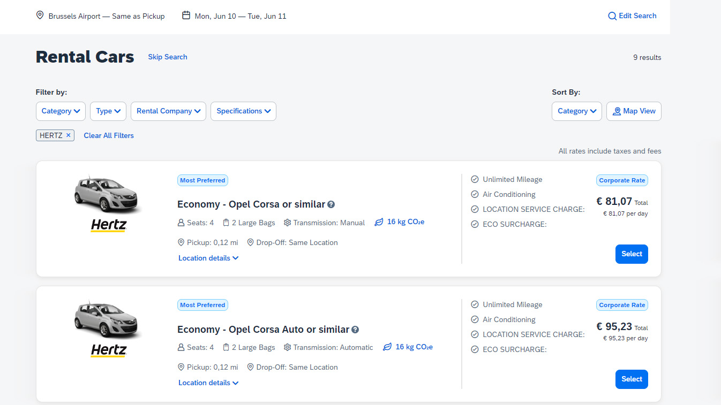
Booking a Rental Car
3
On the Rental Cars results page, you can filter the results by Category, Type, Rental Company, or Specifications (e.g. Electric Cars). You can also sort by distance, Total Cost and other Categories or view the results located on a Google map.
To modify the search query, you can select Edit Search.
4
To continue with the booking process, select a car from the available results.

Slide 4
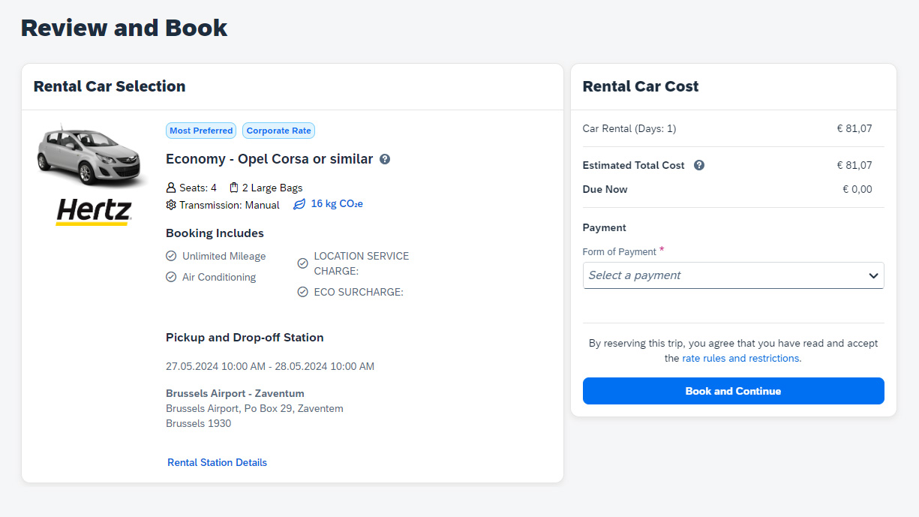
Booking a Rental Car
5
On the Review and Book page, review the rental car selection and cost, traveler information, rental car preferences, rental station details, or the rate rules and restrictions.
6
Choose your form of payment, read the rate rules and restrictions, select your Trip Reason and then select Book and Continue.

Slide 5
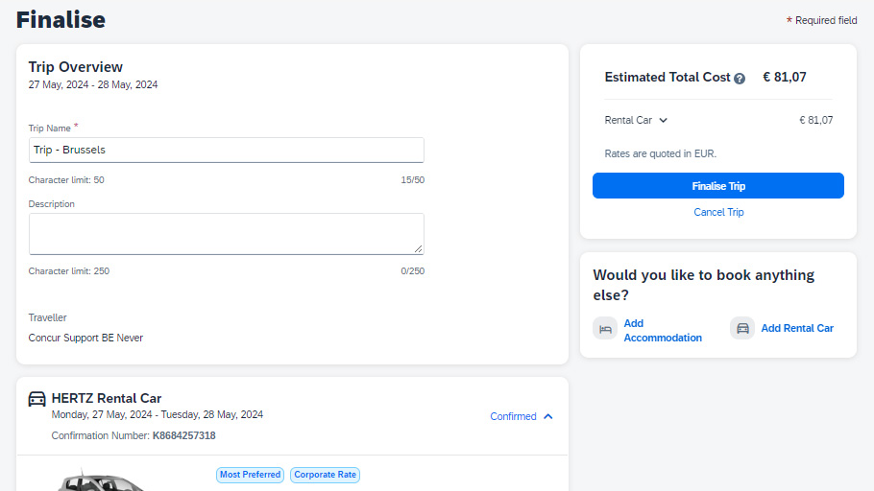
Booking a Rental Car
7
On the Finalize page, review your trip details. You can also edit the trip name and description, view the complete rental car itinerary, confirmation number, rental station details, rate rules and restrictions, and estimated total cost. Select Finalize Trip to complete your booking process or select Cancel Trip to cancel this reservation.
*It is important that you click on Finalize Trip as otherwise your booking will be auto-cancelled by the tool.

Slide 6
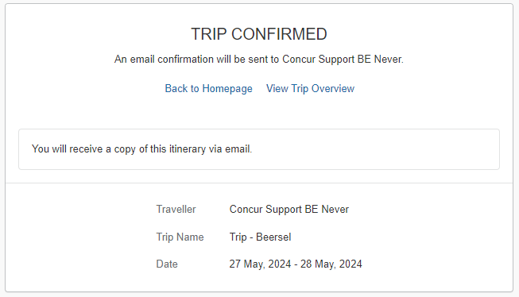
Booking a Rental Car
8
On the Trip Confirmed page, you can select Back to Homepage or View Trip Overview. In this example, you will select View Trip Overview.

Slide 7
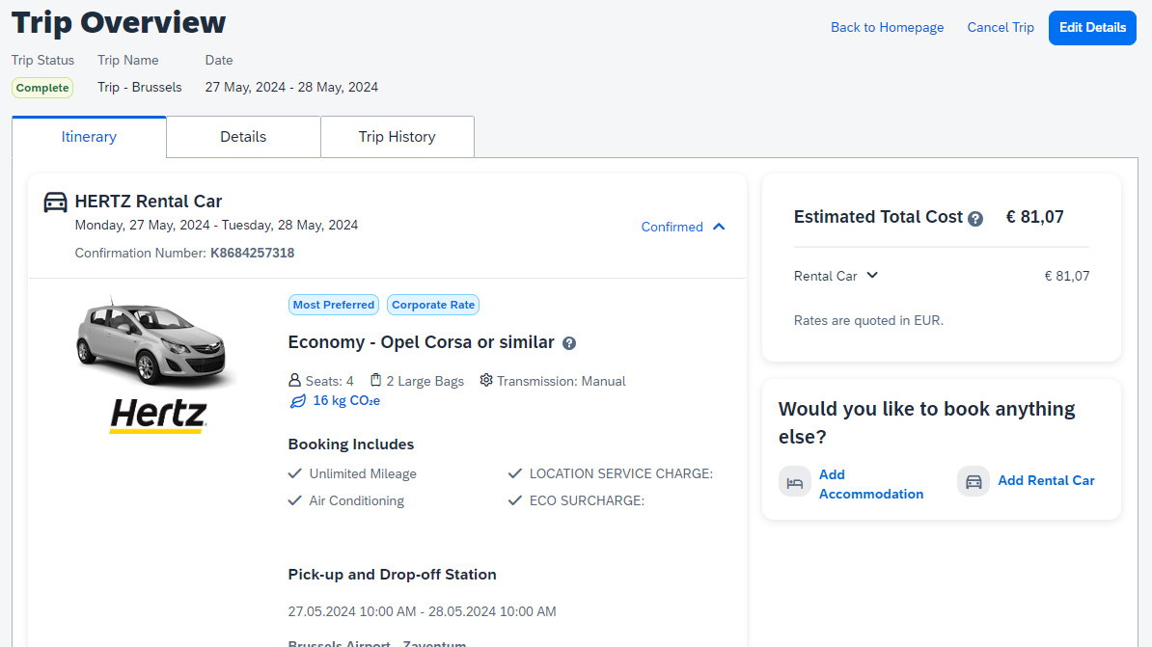
Booking a Rental Car
9
On the Trip Overview page, you can cancel the trip, edit the details (trip name and description), view the itinerary, record locator, rental car details, travel agency and contact details.
*Please note that guest booking (if used in a country) would be on the old workflow.

Slide 8
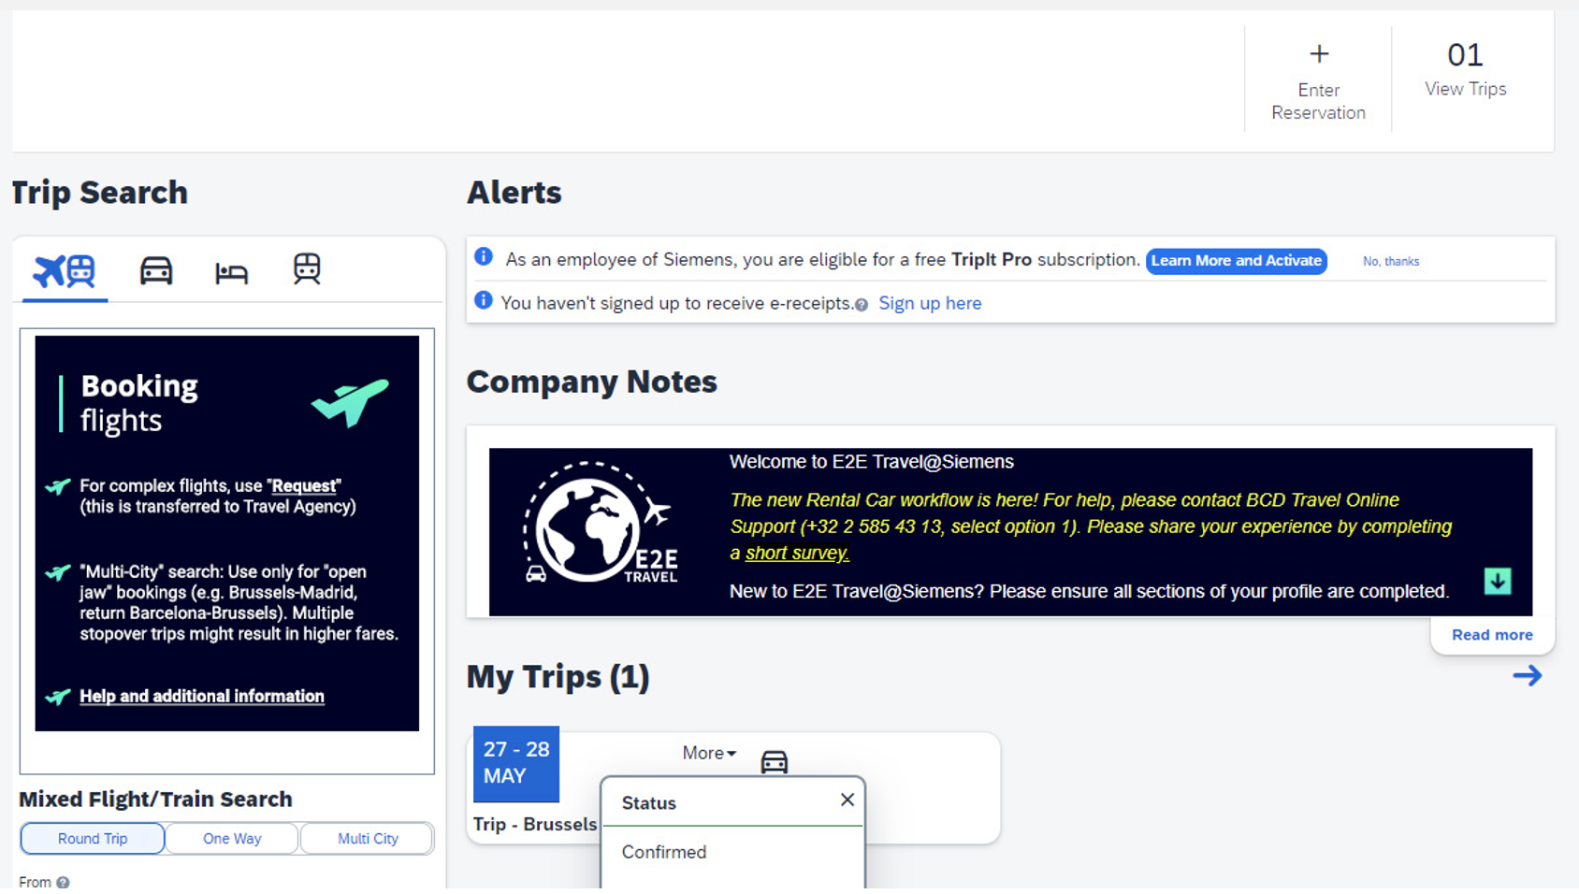
Booking a Rental Car
10
If you select Back to Homepage, you can view the reservation under My Trips on the SAP Concur homepage.

Slide 9

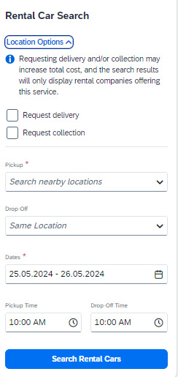

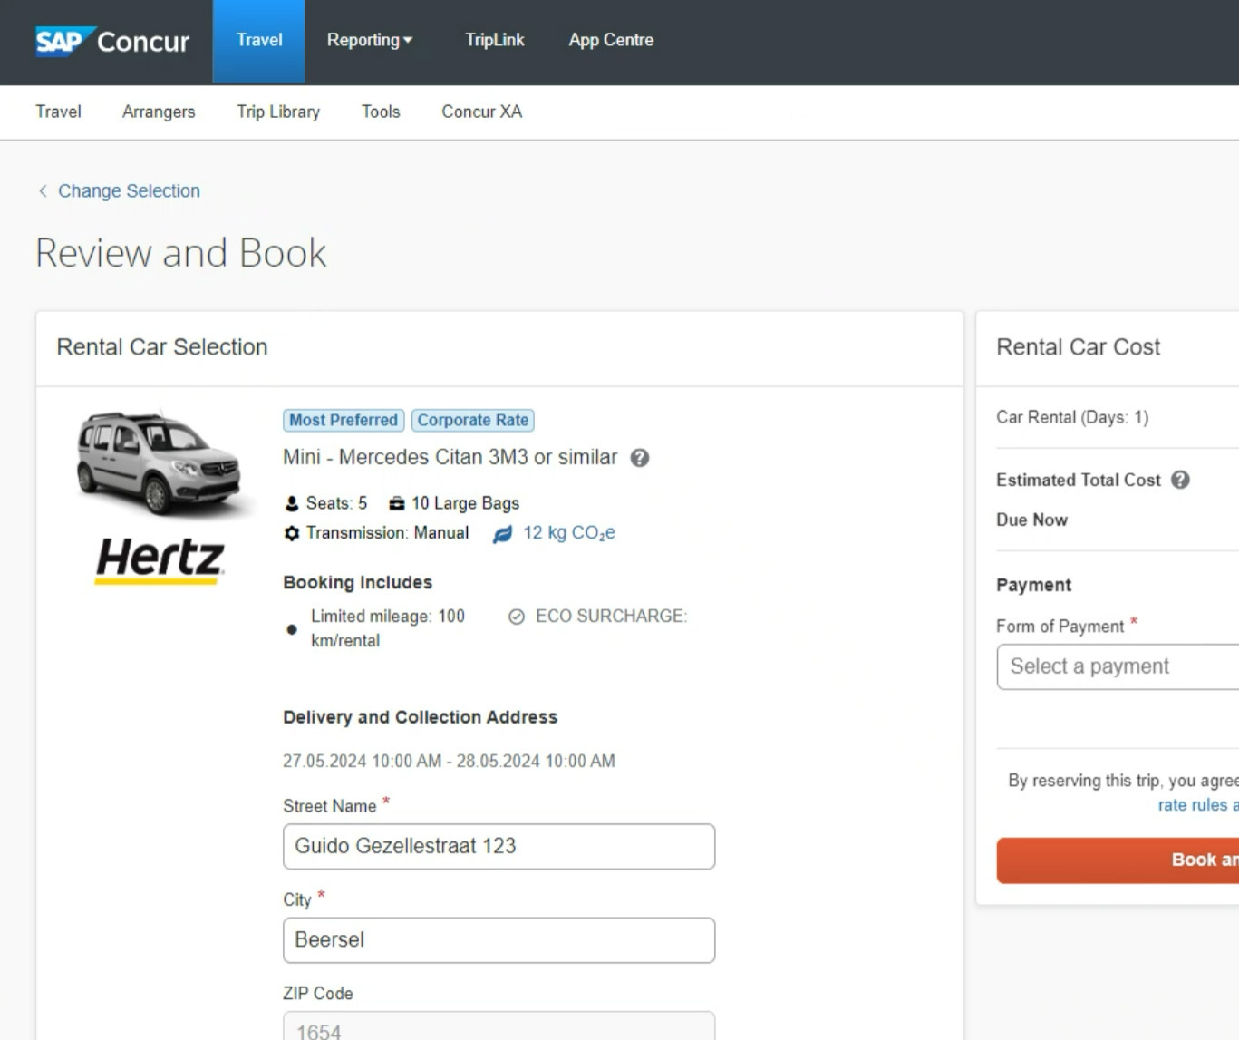
Booking a Rental Car with Delivery and Collection
*Applicable to EMEA travelers only
1
2
1
To book a rental car, on the SAP Concur home page, select the Car tab. For a Delivery & Collection* to your office location, click on Location Options.
3
2
Select Request delivery or Request collection and search/select your office location in the Delivery and Collection fields.
3
Follow steps 4-8 on the previous slides to finalize your car rental booking.

