Slide 1
Booking a Hotel

Slide 2
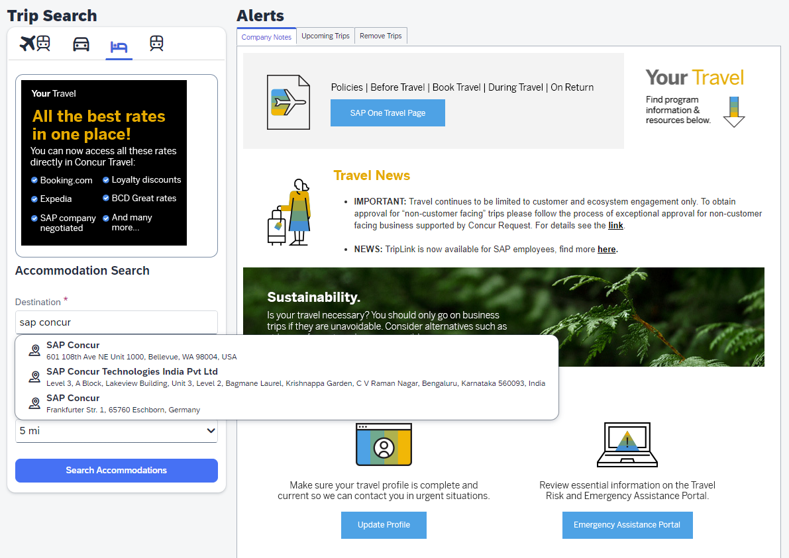
Hotel Search
1
The initial search widget now includes the ability to use omni-search capability to search for lodging based on names of local places, buildings, areas, companies and more.

Slide 3
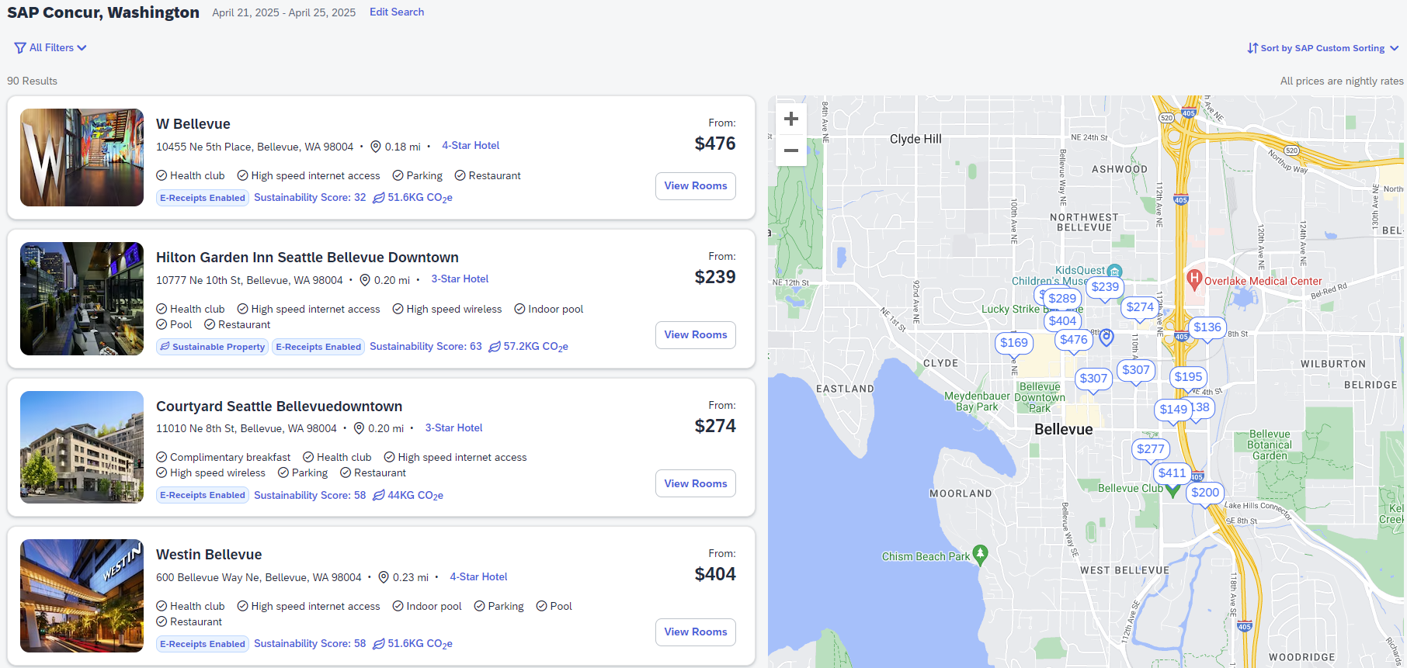
Hotel Search Results
2
The interactive map displays the lowest available rate for each property. Clicking on a rate in the map will cause the property be centered on the left hand display.
3
The lowest available rate is displayed for each property. View Rooms button will display more room rate options
4
Sustainability and CO2e information are prominently displayed

Slide 4
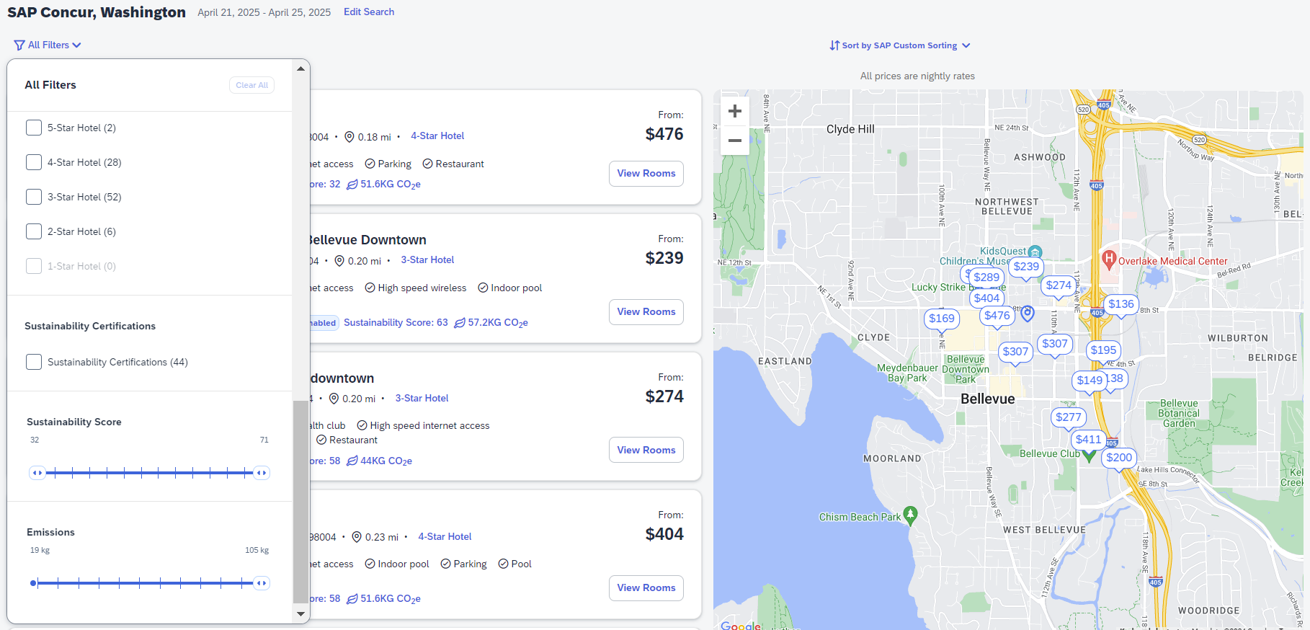
Hotel Search
Sorting capability is expanded to offer highest scoring sustainable properties as a sort option
5
6
Filtering capability is expanded to include Sustainability Certifications and Scores, and Emissions

Slide 5
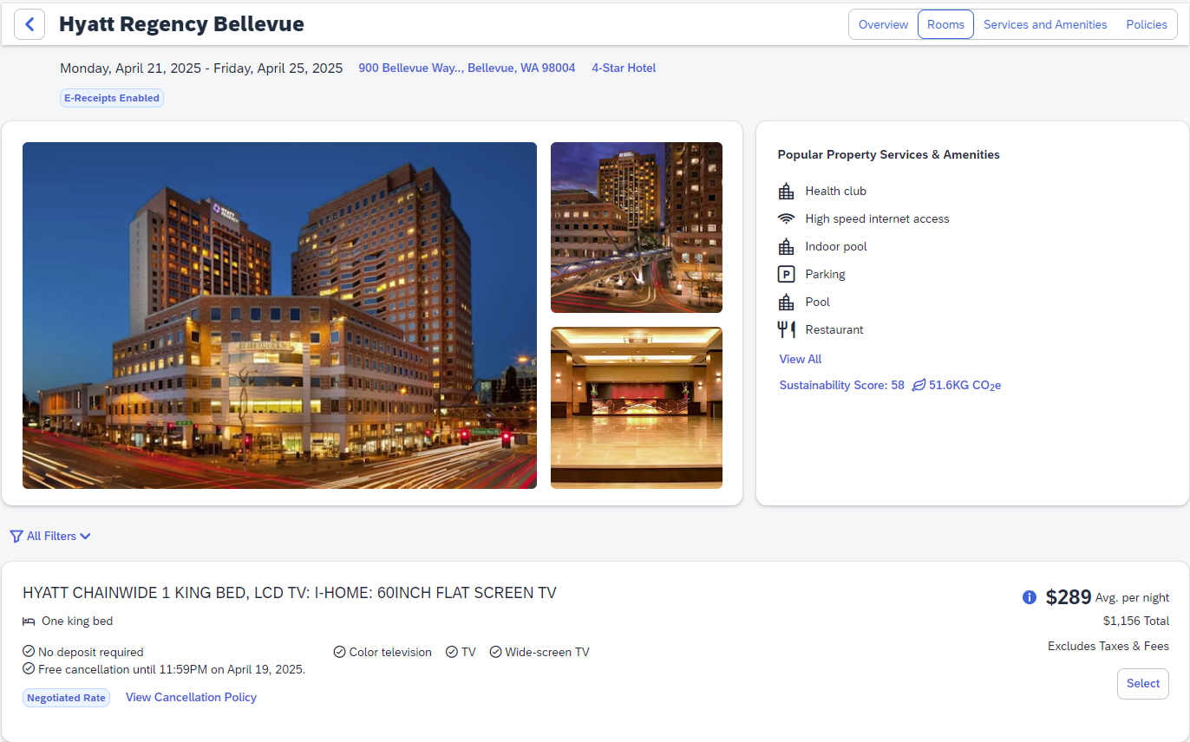
View Rooms
7
Most important Property Services & Amenities are prominently displayed
8
Navigation buttons allow for fast, easy movement to the key sections of information - all on single page
9
Rich imagery provides for a more informed choice

Slide 6
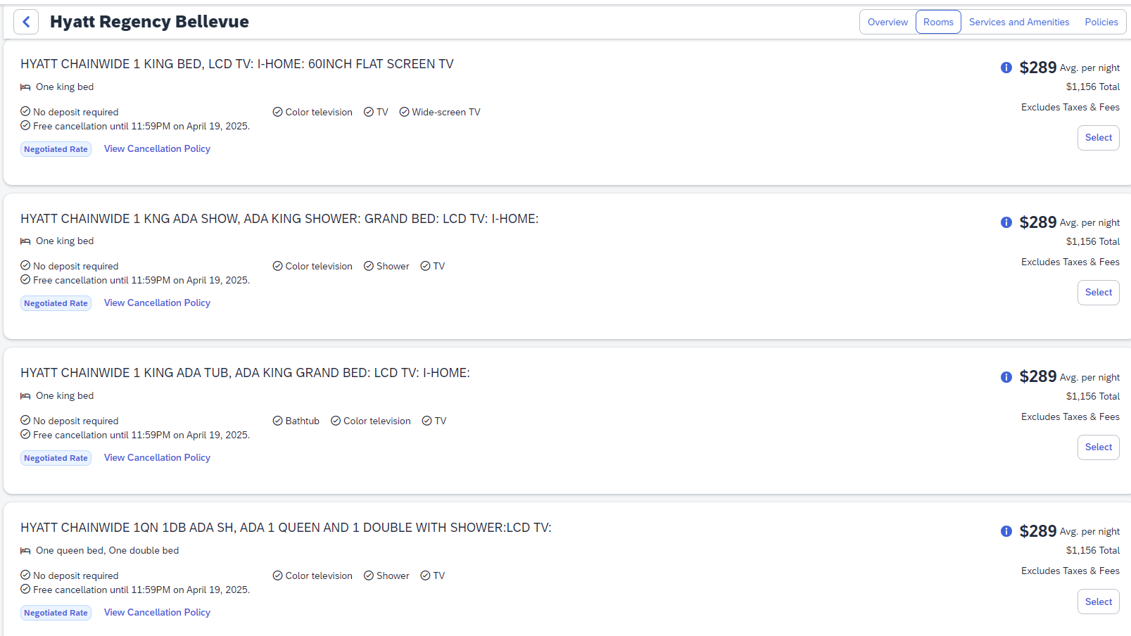
View rooms
10
Rate type, deposit requirements, and cancellation status are prominently displayed to assist with choosing the right fare
11
Select the desired room rate to move to the booking process

Slide 7
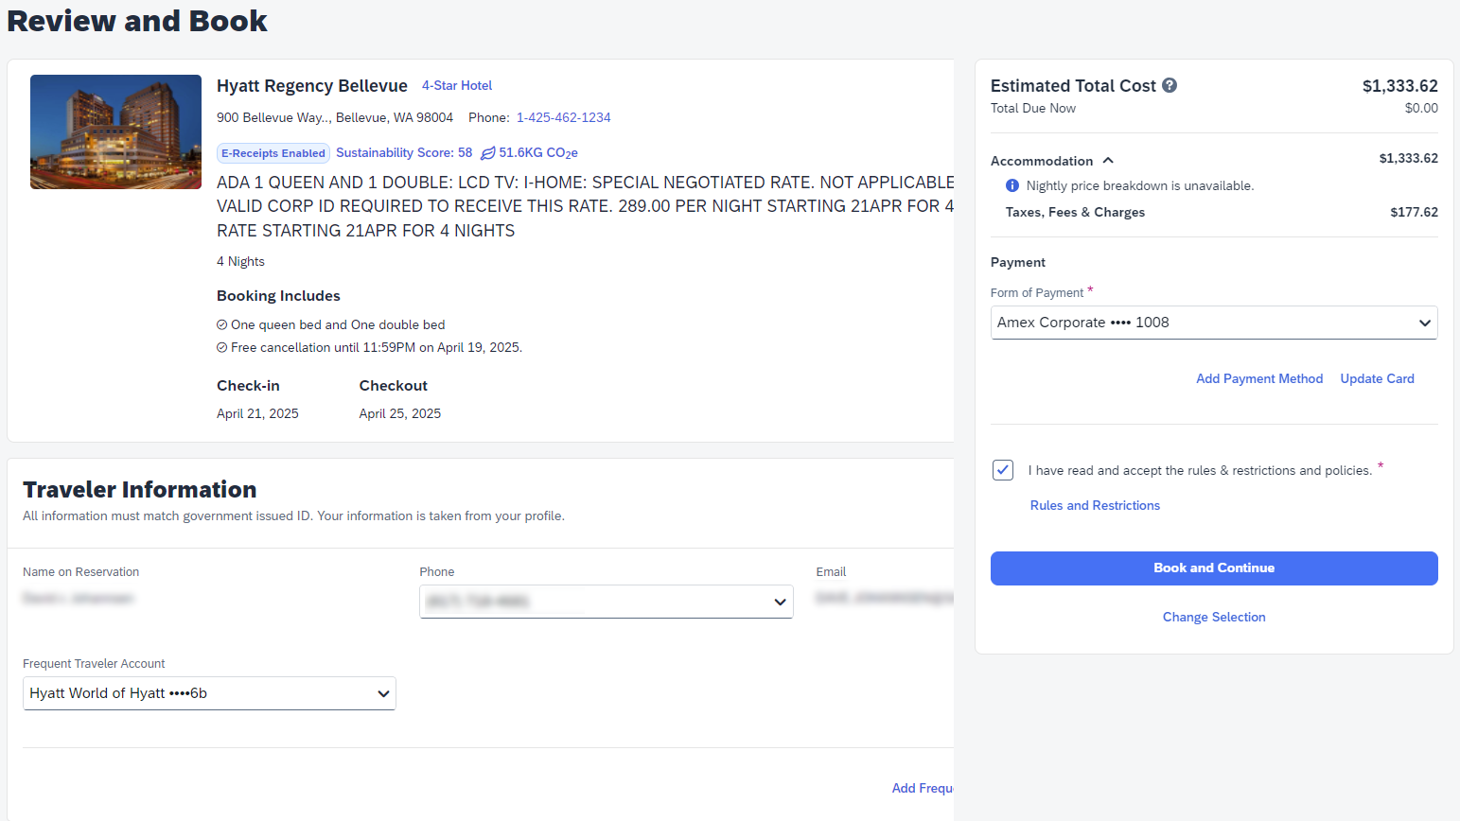
Book
12
Just click book to add this element to the Trip Itinerary

